Slide 1
Project Procurement & Contract Management
Dr. M Asghar Mughal
Lecture 1

Slide 2
SHOULD WE OUTSOURCE ANYTHING?

Slide 3
OUTSOURCING
There are two main arguments against outsourcing; the first is that outsourcing has lead to the drainage of jobs that belong to the American middle class, that those jobs outsourced leads to poorer quality in goods and services produced. problem in outsourcing implementations is a lack of understanding of post-contract processes and decision rights. Some companies, such as Wal-Mart, prefer to do no outsourcing at all, while others do a lot of outsourcing
The second arguments argues that outsourcing leads to Nike has no manufacturing plants of its own but chooses to outsource the work to contractors in the Philippines, Vietnam, China, Indonesia, and Taiwan. There are 500,000 people worldwide involved in the production of Nike footwear
Companies outsource their manufacturing for any number of reasons. Tech giant Apple, renowned for sleek designs and user-friendly interfaces, is also known for outsourcing its manufacturing, especially to China.

Slide 4
IBM – Queensland Disaster
In December 2007, Queensland granted a contract to IBM to create an application to manage payroll for Queensland’s health department. IBM offered $6 million to finish the project by mid-2008. Following a series of unexpected technical problems, IBM informed the state of Queensland that the project would cost $27 million. For several years, the project dragged on, with the payroll platform failing to work correctly. In the meanwhile, thousands of employees were not paid, while others were overpaid. By the end of the project, the cost had risen to $1.2 billion, which was 16,000% more than the original. As a result, the state of Queensland barred IBM from working on any further government projects and sued IBM to recover its losses. Apparently, Queensland had learnt that a well-known seller might produce notorious outcomes

Slide 5
Royal bank of Scotland and their IT vendor
They say “money is everything,” and that is never truer than in the outsourcing failures case study in 2012 by the Royal Bank of Scotland and its unnamed IT vendor. During the event, unable to access their money and losing trust in handing it over to a government bank, many customers moved their businesses to other banks as soon as all was settled.

Slide 6
CORE BUSSINESS
Tesla has never outsourced their software. They have instead developed a proprietary self-driving software that is improved by collecting data from Tesla's network of over one million beta testers
OUTSOURCE FAILURE REASONS
Unclear expectations and risk assessments
Lack of technical expertise
Tight deadlines
Lack of control

Slide 7
ways to avoid outsourcing failures
Determine your outsourcing goals
Choose the right outsourcing vendor
Prioritize value
Draft a written agreement
Pay attention to long-term costs
Account for cultural and productivity differences
Maintain some control over management

Slide 8
Introduction to Project Procurement: Why Procure?
It is nearly impossible for all projects to be totally self-sufficient
Purchase of Product or Service from outside providers sometimes consider necessary
For Example
  If you are constructing a building, you may have resources to complete the project on your own, but for raw material you might have to outsource. For this reason we need procurement management
Procurement management includes management of all contracts and any revision/changes.
It also covers any responsibilities a project team held in completing that contract.

Slide 9
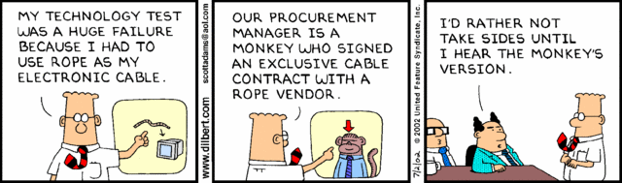
Importance of Project Procurement Management
Procurement means acquiring goods and/or services from an outside source
  Other terms include purchasing and outsourcing
Experts predict that global spending on computer software and services will continue to grow

Slide 10
Procurement Planning
Procurement Planning is the process of identifying which project needs can be best met by procuring products or services outside the project organization and should be accomplished during the scope definition effort. It involves considering whether to procure, how to procure, what to procure, how much to procure, and when to procure.
After making decision of outsourcing a project we then identify:
What types of contract to be used?
Who will be the experts?
What standards forms to be used?
How will the coordination take place?
How will multiple contractors be managed?

Slide 11
Procurement Planning
The stages of procurement include:
  Information gathering (i.e. finding the potential suppliers)
  Supplier contacts (i.e. gathering information about the potential suppliers)
  Background reviews (i.e. vetting, screening, checking references of potential suppliers)
  Negotiations (i.e. setting the price and terms)
  Fulfillment (i.e. delivery and installation)
  Consumption Maintenance, and Disposal (i.e. monitoring the actual delivery and use of the supplies or equipment)
  Renewal (i.e. reorders and continuing relationship with the supplier).

Slide 12
Project Procurement
It is a process required to acquire products, services or results from outside the project team.
Procurement may also be called:
    Acquisition
    Buying
    Contracting
    Purchasing
It is make-or-buy decision;
A contract is a compulsory agreement between two or more parties and is constructed such that one party gives something up (money) and the other party receives something (goods or services) in return.
It is also known as agreement or purchase order
A project might have one contract and sub-contracts

Slide 13
Project Procurement Parties
Different names:
  Buyer = customer, sponsor, owner, client, purchaser
  Seller = vendor, supplier, contractor, provider, sub-contractor
Different perspectives:
  For the buyer, the seller’s work is usually a deliverable or subproject
  For the seller, the contract is often a complete project
Contract
Buyer
Seller
Contract
Contract
Contract

Slide 14
Why Need to Procure for a Project??
To Reduce Cost
To allow the organization to focus on its own core business
To access skills and technology
To provide Flexibility
To increase accountability

Slide 15
Project Procurement Management
It is a process of documenting project procurement decisions, specifying the approach and identifying potential risk that can be involved.
Following steps are involved in project Procurement
Plan Procurement Management
Conduct Procurements
Control Procurements
Close Procurements

Slide 16
Procurement Management
Plan Procurement | Conduct Procurement | Control Procurement | Close Procurement
Outline how procurement management will be conducted on the project | Find and select sources for procurement | Management relations | Finalizes procurements, including any open claims or disputes
Develop make/buy decision making and seller selection process | Develop and finalizes procurement agreements | Monitor performance, Make changes and corrections if necessary | Updates records with procurement results

Slide 17
Planning Procurement management
Make or Buy Analysis
Used to determine whether a particular product can be produced by the performing organization
Analysis should include
  Both indirect and direct costs
  Prospective as well as the immediate needs of the performing organization.
For example:
  Whether a capital goods item can be used for other current or future projects of the organization (ongoing need of the item)
  Additional capacity is available for use within the organization
  Proprietary or business critical activity, which is core business for the company (e.g., designing of chips in a chip manufacturing company)
Cost
Expertise
Focus
legal
Policy
Quality
Risk
time

Slide 18
Make-or-Buy Example
Assume you can lease an item you need for a project for $800/day. To purchase the item, the cost is $12,000 plus a daily operational cost of $400/day.
How long will it take for the purchase cost to be the same as the lease cost?

Slide 19
Make-or Buy Solution
Set up an equation so both options, purchase and lease, are equal.
In this example, use the following equation. Let d be the number of days to use the item:
  $12,000 + $400d = $800d
  Subtracting $400d from both sides, you get:
  $12,000 = $400d
  Dividing both sides by $400, you get:
  d = 30
If you need the item for more than 30 days, it is more economical to purchase it.

Slide 20
Cost benefit Analysis Make or buy
The manager of a fast-food restaurant featuring hamburgers is adding salads to the menu. For each of the two new options, the price to the customer will be the same. The make option is to install a salad bar stocked with vegetables, fruits, and toppings and let the customer assemble the salad. The salad bar would have to be leased and a part-time employee hired. The manager estimates the fixed costs at $12,000 and variable costs totaling $1.50 per salad. The buy option is to have preassembled salads available for sale. They would be purchased from a local supplier at $2.00 per salad. Offering preassembled salads would require installation and operation of additional refrigeration, with an annual fixed cost of $2,400. The manager expects to sell 25,000 salads per year. What is the make-or-buy quantity?

Slide 21
Class Practice Cost benefit analysis
A news clipping service is considering modernization. Rather than manually clipping and photocopying articles of interest and mailing them to its clients, employees electronically input stories from most widely circulated publications into a database. Each new issue is searched for key words, such as a client’s company name, competitors’ names, type of business, and the company’s products, services, and officers. When matches occur, affected clients are instantly notified via an online network. If the story is of interest, it is electronically transmitted, so the client often has the story and can prepare comments for follow-up interviews before the publication hits the street. The manual process has fixed costs of $400,000 per year and variable costs of $6.20 per clipping mailed. The price charged the client is $8.00 per clipping. The computerized process has fixed costs of $1,300,000 per year and variable costs of $2.25 per story electronically transmitted to the client.
a. If the same price is charged for either process, what is the annual volume beyond which the automated process is more attractive?
b. The present volume of business is 225,000 clippings per year. Many of the clippings sent with the current process are not of interest to the client or are multiple copies of the same story appearing in several publications. The news clipping service believes that by improving service and by lowering the price to $4.00 per story, modernization will increase volume to 900,000 stories transmitted per year. Should the clipping service modernize?

Slide 23
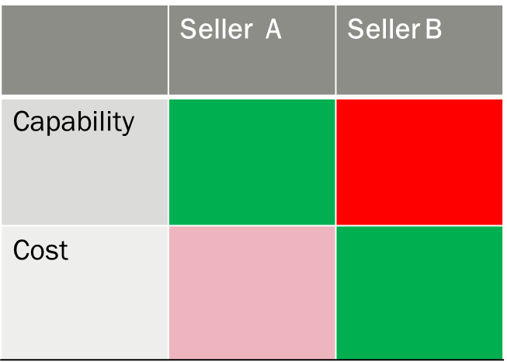
Conduct Procurement
Conduct Procurements is the process of obtaining seller responses, selecting a seller, and awarding a contract. The key benefit of this process is that it provides alignment of internal and external stakeholder expectations through established agreements. Involves receipt of bids or proposals from the sellers and application of the evaluation criteria to select a seller
Tools and Techniques used are:
  Bidder conferences
  Proposal evaluation techniques
  Independent estimates
  Expert judgment
  Advertising
  Internet research
  Procurement negotiations
Important outputs are:
  Procurement contract award
  Selected sellers

Slide 24
Specifications.- PPRA
**(1) The procuring agency shall allow the widest possible competition by defining such specifications that shall not favour any single contractor or supplier nor put others at a disadvantage.
(2) Any terms, specifications, standards, features, characteristics and requirements prescribing the technical or quality characteristics shall be generic in nature and shall not include reference to brand name, model number, catalogue number, name or origin of the country or similar classification.
(3) In case, the procuring agency is convinced that the use of or a reference to a brand name or a catalogue number is essential to complete, an otherwise incomplete specification, and no other sufficiently precise or understandable way of describing the characteristics of the goods, works or services to be procured is provided, the words “or equivalent” shall be used, after recording specific justifications in writing therein. The procuring agency shall be responsible to define the parameters of “equivalence” for all participants to procurement process, to ensure transparency.

Slide 25
Control Procurement
Control Procurements is the process of managing procurement relationships, monitoring contract performance, and making changes and corrections to contracts as appropriate. The key benefit of this process is that it ensures that both the seller's and buyer's performance meets procurement requirements according to the terms of the legal agreement.
Ensures that the seller’s performance meets procurement requirements
Includes application of appropriate project management processes to the contractual relationship(s) and integration of the outputs from these processes into the overall management of the project

Slide 26
Close Procurement
Close Procurements is the process of completing each procurement. The key benefit of this process is that it documents agreements and related documentation for future reference.
Verifies that all work and deliverables from the contract are acceptable
Early termination of the contract is a special case of procurement closure

Slide 27
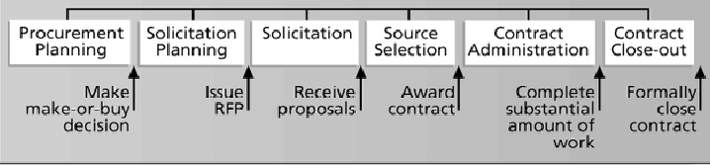
Project Procurement Management process
Procurement planning: Determining what to procure and when
Solicitation planning: Documenting product requirements and identifying potential sources
Solicitation: obtaining quotations, bids, offers or proposals as appropriate
Source Selection: choosing from among potential vendors
Contract administration: managing the relationship with the vendor
Contract close-out: completion and settlement of the contract

Slide 28
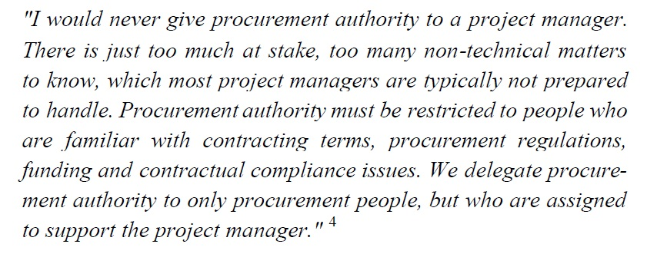
Centralized Vs Decentralized Procurement

Slide 29
Centralized Procurement
Centralized procurement implies that purchasing decisions are made either by company headquarters or some regional or divisional level. When the firm operates a centralized structure/model, a procurement officer at corporate headquarters has the authority for the vast majority of the firm’s procurement spend
Centralization can benefit companies by providing the ability to leverage significant price reductions, and technical and environmental standardization.
Example: Samsung
Advantages of Centralized procurement:
  Production of economies of scale
  Avoiding duplication of efforts
  Reducing mistakes
  Increased specialization
  Knowledge resource sharing

Slide 30
Decentralized Procurement
A decentralized procurement function means that an organization's activities are spread over a number of plants or locations.
Benefits of decentralization lie in reduced opportunities for corruption and less scope for large-scale error and unnecessary overspending
Advantages of Decentralized procurement:
  Specialized local knowledge utilization
  Better stakeholder management
  Time efficient and quick response

Slide 31
Centralized versus Decentralized Procurement Process
If all the contracts of the organizations managed by creating a central contracting or purchasing department, in that case it's called "centralized contraction”
If there can be a separate contract managers assigned to each of the projects, in that case it's called "decentralized contracting” In this case, the contract manager is assigned to the project and reports to the project manager.
In some cases, both type of contracting is used.

